Slide 1
Kademlia Simulation Under High Node Churn
Yantao Luo, Yitao Zhou
05.12.23

Slide 2
Introduction
01
Adopted Kademlia DHT source code as a base for our simulation
02
Created a simulation of node churn
03
Changed different variables in the simulation, including number of nodes, average node lifetime, and different distance functions
04
Tested the performance of model, recorded the success rate and get time

Slide 3
Experimental Setup
Network Size
Node Lifetime
Prioritizing Uptime vs Distance
Investigate the influence of network size on Kademlia's performance. The node lifetime is fixed at 180 seconds, while the network size varies between 10 and 500 nodes.
The main goal is to assess how the size of the network affects the performance of Kademlia.
This set of experiments focuses on the impact of variable node lifetimes on Kademlia's performance.
With a constant network size of 50 nodes, the node lifetime is altered following a normal distribution with a mean time ranging from 60 to 1200 seconds.
This experiment proposes an alternative that prioritizes node uptime rather than XOR distance. We simulate a network with a wide range of node lifetimes to mimic a mix of short and long uptimes.
The aim is to investigate whether prioritizing uptime improves Kademlia's performance.
Notes:
In our project, we designed three benchmark programs to compare characteristics of OpenMP and MPI.

Slide 4
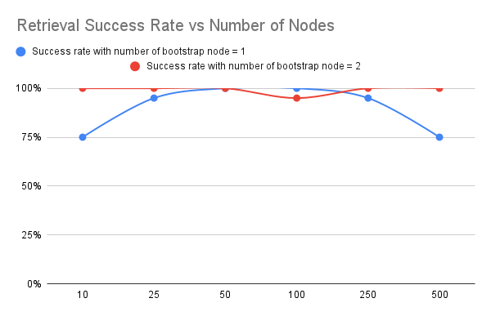
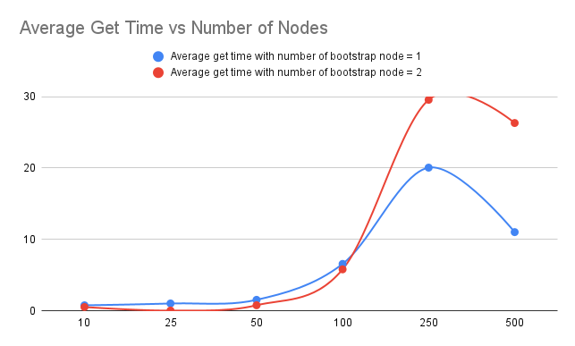
Results and Analysis
Network Size

Slide 5
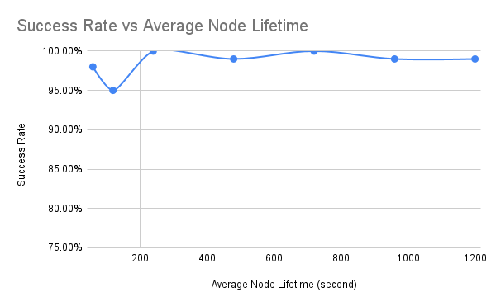
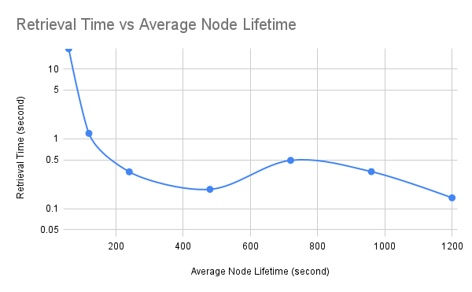
Results and Analysis
Node Lifetime

Slide 6
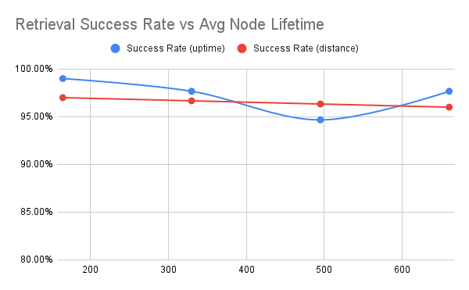
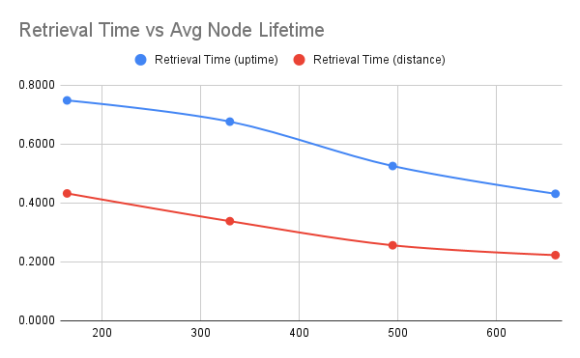
Results and Analysis
Prioritizing Uptime vs Distance

Slide 7
Conclusions
As the number of nodes in the network increased, so did the retrieval time, likely due to the increased number of hops required for a lookup.
While Kademlia ensures high success rates even in the face of high churn rates, it is worth noting that retrieval times can be considerably prolonged when the churn rate is high.
By increasing the number of bootstrap nodes, an improvement in the success rate can be achieved.
Prioritizing nodes based on uptime instead of key space distance increased retrieval success rates, it also significantly lengthened retrieval times.
Notes:
From the literature review and experiment we did, we can conclude three points we have learned about OpenMP and MPI.
First, The overhead of creating a MPI process is 34,000 times greater than that of creating an omp thread in the given machine. For OpenMP, this overhead is linear to the number of threads created. However, for MPI, The overhead gets greater as the number of processes increases.
Second, OpenMP outperformed MPI when the problem size is small. The implicit synchronization mechanism and strong parallel runtime implementation of OpenMP make it more suitable for problems that can be solved using a single shared memory system. In such cases, OpenMP can provide better performance than MPI due to its ability to minimize communication overhead and exploit parallelism within a single node. However, for problems that require distributed memory systems or where the problem size exceeds the available memory on a single node, MPI may be a more appropriate choice for parallelization.
MPI is typically used for inter-node communication in distributed memory systems, while OpenMP is used for intra-node parallelism in shared memory systems. By combining the two, it is possible to take advantage of both types of parallelism and minimize communication overhead. There are still some research to do on combining these two complementary language models.

Slide 8
Literature Survey
Liben-Nowell et al.: Analysis of the Evolution of Peer-to-Peer Systems
Demonstrated the rate of nodes’ participation is a more useful metric comparing with nodes’ run-time, and they give a general lower bound on the rate of node participation for a network to remain connected.
Rhea et al.: Handling Churn in a DHT
Explained existing DHTs hardly handle the scenario of high churn rate.
Present Bamboo, a DHT protocol designed to handle networks with high churn efficiently.
Castro et al.: Performance and dependability of structured peer-to-peer overlays
Optimization of Pastry implementation, MSPastry, to handle consistent routing under churn with low overhead
Notes:
Before we proceed to the experiment part, let’s take a look at literature survey we’ve done.
The first paper compared OpenMP and MPI from the mechanism perspective. They pointed out OpenMP is a language model with fine granularity and implicit synchronization, while MPI is a more coarse-grained message passing model.
The second one designed a set of benchmark programs including Floyd-Warshall algorithm and join problem.
The third one did a very interesting experiment. They asked a group of programmers to solve sharks and fishes problem using OpenMP and MPI. As a result, OpenMP development time was 9.6 hours less than MPI in average.
The last one did a comprehensive comparison of DMP, which stands for distributed memory programming and SMP, which stands for shared memory programming.

Slide 9
Template Notes
This template is part of the NYU Templates collection. Refer to our Usage Guidelines for help topics and quick tips on how to use this template.
Download the Grackle Slides add-on to automatically run accessibility checks on all aspects of your document and get advice on how to make things better.

